Slide 1
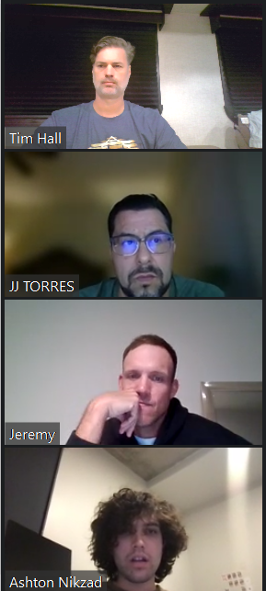
Arizona Residential Real Estate Analysis
Team 2 Presentation

Slide 2
Team Members & Duties
Ashton Nikzad
Jeremy LAST NAME HERE
JJ Torres
Tim Hall
Data importing, cleaning, and analysis:
Jeremy and Ashton
Plots
JJ
Presentation
Tim

Slide 3
Solving for these questions
Question 1:
If you were to invest today, which zip codes have the lowest cost investment per square ft. = (Best Investment)?
Question 2:
Identification of Low Risk, High Yield (Best Investment) Property categorized by Property Type, Bedroom size, community_amenities?
Question 3: Which properties are in foreclosure?

Slide 4
Our Audience:
Small, or Individual, Residential Real Estate Investor(s)
Single Family Buyers
Local Real Estate Agents

Slide 5

Input Data Sources
Rapid API: https://us-real-estate.p.rapidapi.com/v2/for-sale
From Datausa.io
proptaxes.csv
propvalue.csv
rentvsown.csv
state_market_tracker.tsv000
Redfin Real Estate News: https://www.redfin.com/news/data-center/
Median Household Income.csv
Property Values.csv
Property Taxes.csv

Slide 6
Imports
import pandas as pd
import json
import requests
import plotly.express as px
import hvplot.pandas
import geopandas
from urllib.request import urlopen
MORE?

Slide 7
Title and Content Layout with Chart

Slide 8
Title and Content Layout with Table
First bullet point here
Second bullet point here
Third bullet point here
Class | Group 1 | Group 2
Class 1 | 82 | 95
Class 2 | 76 | 88
Class 3 | 84 | 90

Slide 9
Two Content Layout with SmartArt
First bullet point here
Second bullet point here
Third bullet point here
Step 1 Title
Step 2 Title
Step 3 Title
Step 4 Title

Slide 10
If you were to invest today, which zip codes have the lowest cost investment per square ft. = (Best Investment) ?
Question 1

Slide 11
Put a Plot here?

Slide 12
Put a Plot here?

Slide 13
Identification of Low Risk, High Yield (Best Investment) Property categorized by Property Type, Bedroom size, community_amenities?
Question 2

Slide 14
Put a Plot here?

Slide 15
Put a Plot here?

Slide 16
Which properties are in foreclosure?
Question 3

Slide 17
Put a Plot here?

Slide 18
Put a Plot here?

Slide 19
Conclusion
Team 2

Slide 21
Add a Slide Title - 4

Slide 22
Add a Slide Title - 5

